Slide 1
Parallelism in Simulation
Notes:
CS267 Lecture 2
Recall layers:
Applications (this lecture)
Algorithms
Software
Hardware

Slide 2
Parallelism and Locality in Simulation
Parallelism and data locality both critical to performance
  Recall that moving data is the most expensive operation
Real world problems have parallelism and locality:
  Many objects operate independently of others.
  Objects often depend much more on nearby than distant objects.
  Dependence on distant objects can often be simplified.
    Example of all three: particles moving under gravity
Scientific models may introduce more parallelism:
  When a continuous problem is discretized, time dependencies are generally limited to adjacent time steps.
    Helps limit dependence to nearby objects (eg collisions)
  Far-field effects may be ignored or approximated in many cases.
Many problems exhibit parallelism at multiple levels
Notes:
CS267 Lecture 2
Not all problems solved on parallel machines involve simulation, but many do (eg graphics, games,…)
Use particles moving under gravity as example for first bullet
For second bullet, point out that in one time step, may only depend on nearby objects
(eg collisions)

Slide 3
Basic Kinds of Simulation
Discrete event systems:
  “Game of Life,” Manufacturing systems, Finance, Circuits, Pacman, …
Particle systems:
  Billiard balls, Galaxies, Atoms, Circuits, Pinball …
Lumped variables depending on continuous parameters
  Ordinary Differential Equations (ODEs),
  Structural mechanics, Chemical kinetics, Circuits,
Continuous variables depending on continuous parameters
  Partial Differential Equations (PDEs)
  Heat, Elasticity, Electrostatics, Finance, Circuits, Medical Image Analysis,
A given phenomenon can be modeled at multiple levels.
Many simulations combine more than one of these techniques.
Notes:
CS267 Lecture 2
Sorted from most discrete to most continuous
Discrete event: time, and events being simulated are discrete
Game of Life, from Scientific American
Manufacturing: assembly lines
Finance: transactions:
Circuits: digital circuits (gates, transistors) changing at clock ticks
Some (old) computer games, like Pacman
Particles: a little more continuous (time, but still discrete steps)
and positions of particles (but still a discrete set of particles)
like billiard balls bouncing, as in pinball, or stars moving under gravity, or
circuits modeled with moving electrons (running example)
Lumped variables, discrete variables, depending continuously on connected variables,
varying continuously with time;
Circuits (SPICE: ODEs for voltage, resistors, capacitors etc in circuit)
Star Wars: Doing correct structural mechanics simulation when Darth Vader smashed something
All continuous: time and space or other physical quantities are continuous (even though must discretize both to solve)
Heat equation: temperature(position, time)
Finance again: Black-Scholes equation for derivative pricing (Nobel Economics, 1997)
Circuits: Schroedinger Equation if you like,
Terminator 3: detailed simulation of fluid splashing around as former governor was smashing things
Another difference: Star Wars developed at Berkeley, Terminator at Stanford

Slide 4
Outline
discrete
Discrete event systems
  Time and space are discrete
Particle systems
  Important special case of lumped systems
Lumped systems (ODEs)
  Location/entities are discrete, time is continuous
Continuous systems (PDEs)
  Time and space are continuous
  Next lecture
Identify common problems and solutions
continuous
Notes:
CS267 Lecture 2
Goal for next lecture and a half…

Slide 5
A Model Problem: Sharks and Fish
Illustration of parallel programming
  Original version (discrete event only) proposed by Geoffrey Fox
  Called WATOR
Basic idea: sharks and fish living in an ocean
  rules for movement (discrete and continuous)
  breeding, eating, and death
  forces in the ocean
  forces between sea creatures
6 problems (S&F1 - S&F6)
  Different sets of rules, to illustrate different phenomena
Available in many languages (see class web page)
  Matlab, pThreads, MPI, OpenMP (not all problems in all languages)
Some homework based on these
Notes:
CS267 Lecture 2
“fish gravity” creates schools of fish swimming around

Slide 6
The Game of Life
Board game - theoretically infinite two-dimensional array of cells. Each cell can hold one “organism” and has eight neighboring cells, including those diagonally adjacent. Initially, some cells occupied. The following rules apply:
1. Every organism with two or three neighboring organisms
survives for the next generation.
2. Every organism with four or more neighbors dies from
overpopulation.
3. Every organism with one neighbor or none dies from isolation.
4. Each empty cell adjacent to exactly three occupied neighbors
will give birth to an organism.
These rules were derived by Conway “after a long period of experimentation.”
6.<number>

Slide 7
Simple Fun Examples of Cellular Automata
“Sharks and Fishes”
An ocean could be modeled as a three-dimensional array of cells.
Each cell can hold one fish or one shark (but not both).
Fish and sharks follow “rules.”
6.<number>

Slide 8
Fish
Might move around according to these rules:
If there is one empty adjacent cell, the fish moves to this cell.
2. If there is more than one empty adjacent cell, the fish moves to one cell chosen at random.
3. If there are no empty adjacent cells, the fish stays where it is.
4. If the fish moves and has reached its breeding age, it gives birth to a baby fish, which is left in the vacating cell.
5. Fish die after x generations.
6.<number>

Slide 9
Sharks
Might be governed by the following rules:
1. If one adjacent cell is occupied by a fish, the shark moves to this cell and eats the fish.
2. If more than one adjacent cell is occupied by a fish, the shark chooses one fish at random, moves to the cell occupied by the fish, and eats the fish.
3. If no fish are in adjacent cells, the shark chooses an unoccupied adjacent cell to move to in a similar manner as fish move.
4. If the shark moves and has reached its breeding age, it gives birth to a baby shark, which is left in the vacating cell.
5. If a shark has not eaten for y generations, it dies.
6.<number>

Slide 10
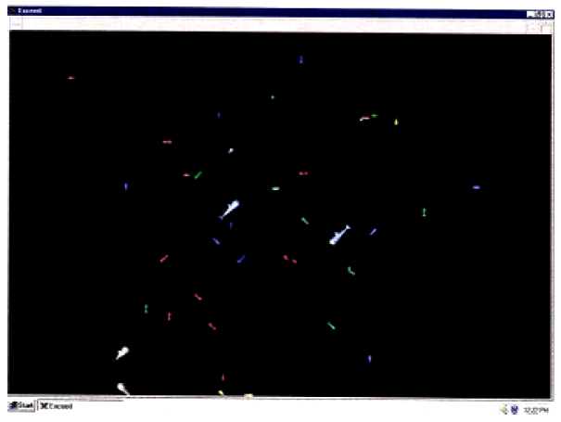
Sample Student Output
6.<number>
6.68

Slide 11
Sharks and Fish
S&F 1. Fish alone move continuously subject to an external current and Newton's laws.
S&F 2. Fish alone move continuously subject to gravitational attraction and Newton's laws.
S&F 3. Fish alone play the "Game of Life" on a square grid.
S&F 4. Fish alone move randomly on a square grid, with at most one fish per grid point.
S&F 5. Sharks and Fish both move randomly on a square grid, with at most one fish or shark per grid point, including rules for fish attracting sharks, eating, breeding and dying.
S&F 6. Like Sharks and Fish 5, but continuous, subject to Newton's laws.
Notes:
CS267 Lecture 2
SF2: like HW2 but no collisions
SF4: need to keep at most one fish per cell,
so need to deal with possible races, deadlock
SF6: rules, not implementation

Slide 12
Discrete Event Systems
Notes:
CS267 Lecture 2

Slide 13
Discrete Event Systems
Systems are represented as:
  finite set of variables.
  the set of all variable values at a given time is called the state.
  each variable is updated by computing a transition function depending on the other variables.
System may be:
  synchronous: at each discrete timestep evaluate all transition functions; also called a state machine.
  asynchronous: transition functions are evaluated only if the inputs change, based on an “event” from another part of the system; also called event driven simulation.
Example: The “game of life:”
  Also known as Sharks and Fish #3:
  Space divided into cells, rules govern cell contents at each step
Notes:
CS267 Lecture 2
Asynchronous: may or may not be clock

Slide 14
Parallelism in Game of Life (S&F 3)
The simulation is synchronous
  use two copies of the grid (old and new), “ping-pong” between them
  the value of each new grid cell depends only on 9 cells (itself plus 8 neighbors) in old grid.
  simulation proceeds in timesteps-- each cell is updated at every step.
Easy to parallelize by dividing physical domain: Domain Decomposition
Locality is achieved by using large patches of the ocean
  Only boundary values from neighboring patches are needed.
How to pick shapes of domains?
P4
Repeat
compute locally to update local system
barrier()
exchange state info with neighbors
finish updates
until done simulating
P1
P2
P3
P5
P6
P7
P8
P9
Notes:
CS267 Lecture 2
Only need two grids: ping pong between them
Note: DD also refers to related numerical technique, here we mean just dividing the physical domain

Slide 15
Regular Meshes (e.g. Game of Life)
Suppose graph is nxn mesh with connection NSEW neighbors
Which partition has less communication? (n=18, p=9)
Minimizing communication on mesh ≡ minimizing “surface to volume ratio” of partition
n*(p-1)
edge crossings
2*n*(p^{1/2} –1)
edge crossings
Notes:
CS267 Lecture 2
Spheres (or circles) would minimize surface-to-volume
(or perimeter-to-area) ratio, but they don’t’ “tile” the cube (or plane)

Slide 16
Sharks & Fish in Loosely Connected Ponds
Parallelization: each processor gets a set of ponds with roughly equal total area
  work is proportional to area, not number of creatures
One pond can affect another (through streams) but infrequently
Notes:
CS267 Lecture 2
Natural to assign ponds to processors
How to take advantage of likely infrequent events along narrow connectors?

Slide 17
Particle Systems
Notes:
CS267 Lecture 2

Slide 18
Particle Systems
A particle system has
  a finite number of particles
  moving in space according to Newton’s Laws (i.e. F = ma)
  time is continuous
Examples
  stars in space with laws of gravity
Reminder: many simulations combine techniques such as particle simulations with some discrete events (Ex Sharks and Fish)
Notes:
CS267 Lecture 2

Slide 19
Forces in Particle Systems
Force on each particle can be subdivided
force = external_force + nearby_force + far_field_force
External force
  ocean current in sharks and fish world
  externally imposed electric field in electron beam
Nearby force
  sharks attracted to eat nearby fish (S&F 5)
  balls on a billiard table bounce off of each other
Far-field force
  fish attract other fish by gravity-like (1/r^2 ) force (S&F 2)
Notes:
CS267 Lecture 2
Van der Waals: model of attraction of dipoles and multipoles
Gecko feet: see wikipedia
Far field: seek O(n) algorithms, not obvious O(n^2) when possible

Slide 20
Example S&F 1: Fish in an External Current
% fishp = array of initial fish positions (stored as complex numbers)
% fishv = array of initial fish velocities (stored as complex numbers)
% fishm = array of masses of fish
% tfinal = final time for simulation (0 = initial time)
% Algorithm: integrate using Euler's method with varying step size
% Initialize time step, iteration count, and array of times
dt = .01; t = 0;
% loop over time steps
while t < tfinal,
t = t + dt;
fishp = fishp + dt*fishv;
accel = current(fishp)./fishm; % current depends on position
fishv = fishv + dt*accel;
% update time step (small enough to be accurate, but not too small)
dt = min(.1*max(abs(fishv))/max(abs(accel)),1);
end
Notes:
CS267 Lecture 2
current(position) is a function that returns force from current on fish
located at the given position
Algorithm: Euler = straight line approximation
One complex number gives position in 2D, same for velocity, acceleration
Timestep update: fastest fish changes its velocity by at most about 10%
dt update only communication

Slide 21
Parallelism in External Forces
These are the simplest
The force on each particle is independent
Called “embarrassingly parallel”
Evenly distribute particles on processors
  Any distribution works
  Locality is not an issue, no communication
For each particle on processor, apply the external force
  Also called “map”
  May need to “reduce” (eg compute maximum) to compute time step, other data
Notes:
CS267 Lecture 2

Slide 22
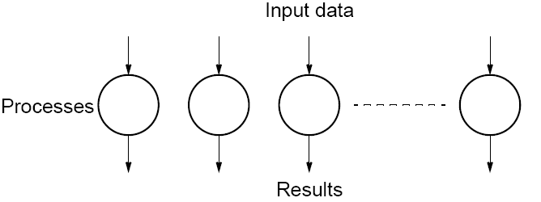
Embarrassingly Parallel Computations
A computation that can obviously be divided into a number of completely independent parts, each of which can be executed by a separate process(or).
No communication or very little communication between processes
Each process can do its tasks without any interaction with other processes
3.3

Slide 23
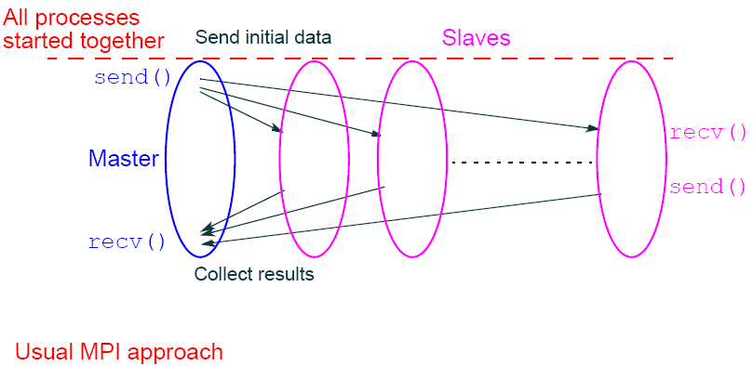
Practical embarrassingly parallel computation with static process creation and master-slave approach
3.4

Slide 24
Parallelism in Nearby Forces
Nearby forces require interaction and therefore communication.
Force may depend on other nearby particles:
  Example: collisions.
  simplest algorithm is O(n²): look at all pairs to see if they collide.
Usual parallel model is domain decomposition of physical region in which particles are located
  O(n/p) particles per processor if evenly distributed.
Notes:
CS267 Lecture 2
often called “domain decomposition,” but the term also refers to a numerical technique.

Slide 25
Parallelism in Nearby Forces
Challenge 1: interactions of particles near processor boundary:
  need to communicate particles near boundary to neighboring processors.
    Region near boundary called “ghost zone”
  Low surface to volume ratio means low communication.
    Use squares, not slabs, to minimize ghost zone sizes
Communicate particles in boundary region to neighbors
Need to check for collisions between regions
Notes:
CS267 Lecture 2

Slide 26
Parallelism in Nearby Forces
Challenge 2: load imbalance, if particles cluster:
  galaxies, electrons hitting a device wall.
To reduce load imbalance, divide space unevenly.
  Each region contains roughly equal number of particles.
  Quad-tree in 2D.
Example: each square contains at most 3 particles
Notes:
CS267 Lecture 2
Do we need to update decomposition as particles move?
Hopefully pick timestep small enough so that balance
Changes slowly

Slide 27
Parallelism in Far-Field Forces
Far-field forces involve all-to-all interaction and therefore communication.
Force depends on all other particles:
  Just decomposing space does not help since every particle needs to “visit” every other particle.
Use more clever algorithms to reduce communication
Use more clever algorithms to beat O(n²).
Implement by rotating particle sets.
Keeps processors busy
All processors eventually see all particles
Notes:
CS267 Lecture 2

Slide 28
Far-field Forces: Particle-Mesh Methods
Based on approximation:
  Superimpose a regular mesh.
  “Move” particles to nearest grid point.
Exploit fact that the far-field force satisfies a PDE that is easy to solve on a regular mesh:
  FFT, multigrid (described in future lectures)
  Cost drops to O(n log n) or O(n) instead of O(n²)
Accuracy depends on the fineness of the grid is and the uniformity of the particle distribution.
1) Particles are moved to nearby mesh points (scatter)
2) Solve mesh problem
3) Forces are interpolated at particles from mesh points (gather)
Notes:
CS267 Lecture 2
Data structures: a 1D array of particles (each with a location)
a 2D (or 3D) array representing the mesh
Scatter: store particle value (say mass) at nearby mesh point
Gather: read forces from mesh, using particle location as index (as in scatter)

Slide 29
Far-field forces: Tree Decomposition
Based on approximation.
  Forces from group of far-away particles “simplified” -- resembles a single large particle.
  Use tree; each node contains an approximation of descendants.
Also O(n log n) or O(n) instead of O(n²).
  Barnes-Hut algorithm.
Notes:
CS267 Lecture 2

Slide 30
Summary of Particle Methods
Model contains discrete entities, namely, particles
Time is continuous – must be discretized to solve
Simulation follows particles through timesteps
  Force = external _force + nearby_force + far_field_force
  All-pairs algorithm is simple, but inefficient, O(n²)
  Particle-mesh methods approximates by moving particles to a regular mesh, where it is easier to compute forces
  Tree-based algorithms approximate by treating set of particles as a group, when far away
Notes:
CS267 Lecture 2

Slide 31
ODEs
Notes:
CS267 Lecture 2

Slide 32
Solving ODEs
In these examples, and most others, the matrices are sparse:
  i.e., most array elements are 0.
  neither store nor compute on these 0’s.
  Sparse because each component only depends on a few others
Given a set of ODEs, two kinds of questions are:
  Compute the values of the variables at some time t
    Explicit methods
    Implicit methods
  Compute modes of vibration
    Eigenvalue problems
Notes:
CS267 Lecture 2
Reason is a locality property from physics.

Slide 33
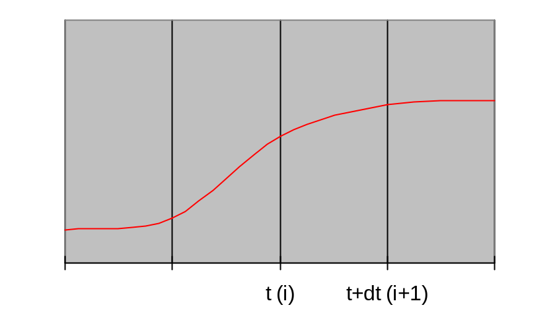
Solving ODEs: Explicit Methods
Assume ODE is x’(t) = f(x) = A*x(t), where A is a sparse matrix
  Compute x(i*dt) = x[i]
  at i=0,1,2,…
  ODE gives x’(i*dt) = slope
  x[i+1]=x[i] + dt*slope
Explicit methods, e.g., (Forward) Euler’s method.
  Approximate x’(t)=A*x(t) by (x[i+1] - x[i] )/dt = A*x[i].
  x[i+1] = x[i]+dt*A*x[i], i.e. sparse matrix-vector multiplication.
Tradeoffs:
  Simple algorithm: sparse matrix vector multiply.
  Stability problems: May need to take very small time steps, especially if system is stiff (i.e. A has some large entries, so x can change rapidly).
Use slope at x[i]
Notes:
CS267 Lecture 2

Slide 34
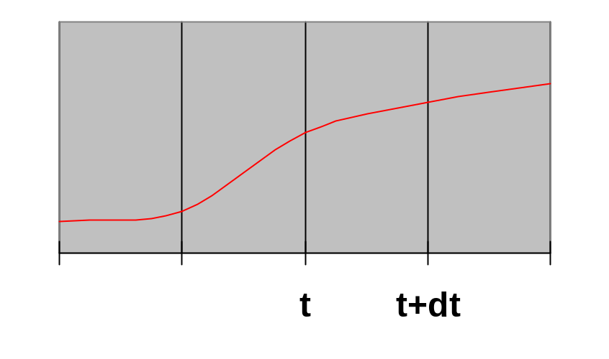
Solving ODEs: Implicit Methods
Assume ODE is x’(t) = f(x) = A*x(t) , where A is a sparse matrix
  Compute x(i*dt) = x[i]
  at i=0,1,2,…
  ODE gives x’((i+1)*dt) = slope
  x[i+1]=x[i] + dt*slope
Implicit method, e.g., Backward Euler solve:
  Approximate x’(t)=A*x(t) by (x[i+1] - x[i] )/dt = A*x[i+1].
  (I - dt*A)*x[i+1] = x[i], i.e. we need to solve a sparse linear system of equations.
Trade-offs:
  Larger timestep possible: especially for stiff problems
  More difficult algorithm: need to solve a sparse linear system of equations at each step
Use slope at x[i+1]
t (i) t + dt (i+1)
Notes:
CS267 Lecture 2

Slide 35
Solving ODEs: Eigensolvers
Computing modes of vibration: finding eigenvalues and eigenvectors.
  Seek solution of d² x(t)/dt² = A*x(t) of form x(t) = sin(ω*t) * x₀, where x₀ is a constant vector
    ω called the frequency of vibration
    x₀ sometimes called a “mode shape”
  Plug in to get -ω² *x₀ = A*x₀, so that –ω² is an eigenvalue and x₀ is an eigenvector of A.
  Solution schemes reduce either to sparse-matrix multiplication, or solving sparse linear systems.
Notes:
CS267 Lecture 2

Slide 36
Implicit Methods; Eigenproblems
Implicit methods for ODEs need to solve linear systems
Direct methods (Gaussian elimination)
  Called LU Decomposition, because we factor A = L*U.
  Future lectures will consider both dense and sparse cases.
  More complicated than sparse-matrix vector multiplication.
Iterative solvers
  Will discuss several of these in future.
    Jacobi, Successive over-relaxation (SOR) , Conjugate Gradient (CG), Multigrid,...
  Most have sparse-matrix-vector multiplication in kernel.
Eigenproblems
  Future lectures will discuss dense and sparse cases.
  Also depend on sparse-matrix-vector multiplication, direct methods.
Notes:
CS267 Lecture 2

Slide 37
ODEs and Sparse Matrices
All these problems reduce to sparse matrix problems
  Explicit: sparse matrix-vector multiplication (SpMV).
  Implicit: solve a sparse linear system
    direct solvers (Gaussian elimination).
    iterative solvers (use sparse matrix-vector multiplication).
  Eigenvalue/vector algorithms may also be explicit or implicit.
Conclusion: SpMV is key to many ODE problems
  Relatively simple algorithm to study in detail
  Two key problems: locality and load balance
Notes:
CS267 Lecture 2

Slide 38
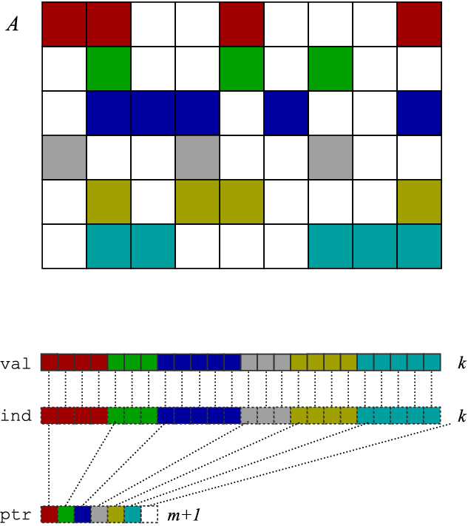
SpMV in Compressed Sparse Row (CSR) Format
SpMV: y = y + A*x, only store, do arithmetic, on nonzero entries
CSR format is simplest one of many possible data structures for A
x
Representation of A
A
y
Matrix-vector multiply kernel: y(i) ← y(i) + A(i,j)⋅x(j)
Matrix-vector multiply kernel: y(i) ← y(i) + A(i,j)⋅x(j)
for each row i
for k=ptr[i] to ptr[i+1]-1 do
y[i] = y[i] + val[k]*x[ind[k]]
Matrix-vector multiply kernel: y(i) ← y(i) + A(i,j)⋅x(j)
for each row i
for k=ptr[i] to ptr[i+1]-1 do
y[i] = y[i] + val[k]*x[ind[k]]
Notes:
CS267 Lecture 2
A one-slide crash course on a basic sparse matrix data structure (compressed sparse row, or CSR, format) and a basic kernel: matrix-vector multiply.
In CSR: store each non-zero value, but also need extra index for each non-zero → less than dense, but higher “rate” of storage per non-zero.
Matrix-vector multiply (MVM): no re-use of A, just of vectors x and y, taken to be dense.
MVM with CSR storage: indirect/irregular accesses to x!
So what you’d like to do is:
Unroll the k loop → but you need to know how many non-zeors per row
Hoist y[i] → not a problem, absent aliasing
Eliminate ind[i] → it’s an extra load, but you need to know the non-zero pattern
Reuse elements of x → but you need to know the non-zero pattern

Slide 39
Parallel Sparse Matrix-vector multiplication
y = A*x, where A is a sparse n x n matrix
Questions
  which processors store
    y[i], x[i], and A[i,j]
  which processors compute
    y[i] = sum (from 1 to n) A[i,j] * x[j]
    = (row i of A) * x … a sparse dot product
Partitioning
  Partition index set {1,…,n} = N1 ∪ N2 ∪ … ∪ Np.
  For all i in Nk, Processor k stores y[i], x[i], and row i of A
  For all i in Nk, Processor k computes y[i] = (row i of A) * x
    “owner computes” rule: Processor k compute the y[i]s it owns.
x
P1
P2
P3
P4
y
May require communication
Notes:
CS267 Lecture 2

Slide 40
Matrix Reordering via Graph Partitioning
“Ideal” matrix structure for parallelism: block diagonal
  p (number of processors) blocks, can all be computed locally.
  If no non-zeros outside these blocks, no communication needed
Can we reorder the rows/columns to get close to this?
  Most nonzeros in diagonal blocks, few outside
P0 P1 P2 P3 P4
P0
P1
P2
P3
P4
=
*
Notes:
CS267 Lecture 2

Slide 41
Goals of Reordering
Performance goals
  balance load (how is load measured?).
    Approx equal number of nonzeros (not necessarily rows)
  balance storage (how much does each processor store?).
    Approx equal number of nonzeros
  minimize communication (how much is communicated?).
    Minimize nonzeros outside diagonal blocks
    Related optimization criterion is to move nonzeros near diagonal
  improve register and cache re-use
    Group nonzeros in small vertical blocks so source (x) elements loaded into cache or registers may be reused (temporal locality)
    Group nonzeros in small horizontal blocks so nearby source (x) elements in the cache may be used (spatial locality)
Other algorithms reorder for other reasons
  Reduce # nonzeros in matrix after Gaussian elimination
  Improve numerical stability
Notes:
CS267 Lecture 2

Slide 42
Graph Partitioning and Sparse Matrices
Relationship between matrix and graph
1 2 3 4 5 6
1 1 1 1
2 1 1 1 1
3 1 1 1
4 1 1 1 1
5 1 1 1 1
6 1 1 1 1
3
4
2
1
6
5
Edges in the graph are nonzero in the matrix: here the matrix is symmetric (edges are unordered) and weights are equal (1)
If divided over 3 procs, there are 14 nonzeros outside the diagonal blocks, which represent the 7 (bidirectional) edges
Notes:
CS267 Lecture 2

Slide 43
Summary: Common Problems
Load Balancing
  Dynamically – if load changes significantly during job
  Statically - Graph partitioning
    Discrete systems
    Sparse matrix vector multiplication
Linear algebra
  Solving linear systems (sparse and dense)
  Eigenvalue problems will use similar techniques
Fast Particle Methods
  O(n log n) instead of O(n²)
Notes:
CS267 Lecture 2

Slide 44
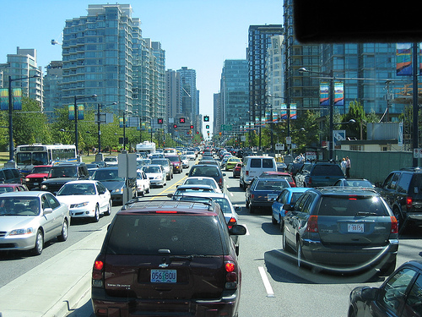
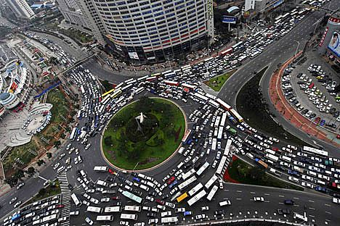
Introduction to traffic control
Traffic Flow Models
Microscopic – ODE
Macroscopic – PDE
Macroscopic ODE Models?
Notes:
PDE – time and space

Slide 45
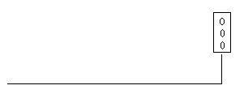
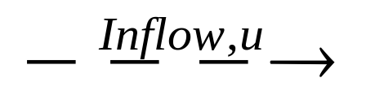
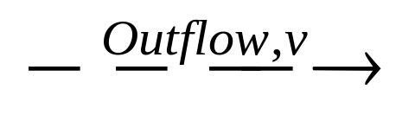
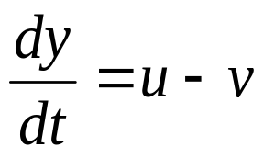
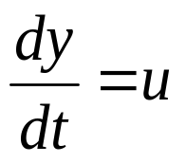
Basics
Total Link Volume = y
Red light:
Green light:
Goal: find y(t)
MATLAB ODE numerical solver “ode15s”
Notes:
Ode15s: Runge-Kutta finite differences formula
Stiff: method is numerically unstable

Slide 46
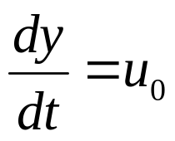
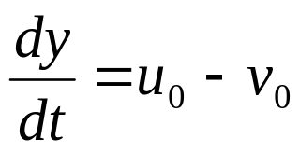
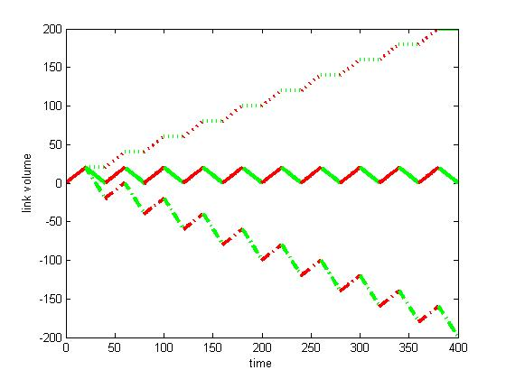
Constant Model
Red Light:
Green Light:
u0 > u0 - v0:
linear growth
u0 = u0 - v0 :
equilibrium
u0 < u0 - v0 :
linear decay
RL = GL = 20; u0 =1
v₀ =2
v₀ =1
v₀ =3
Notes:
Axes; color; RL/GL

Slide 47
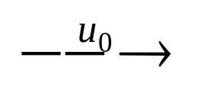
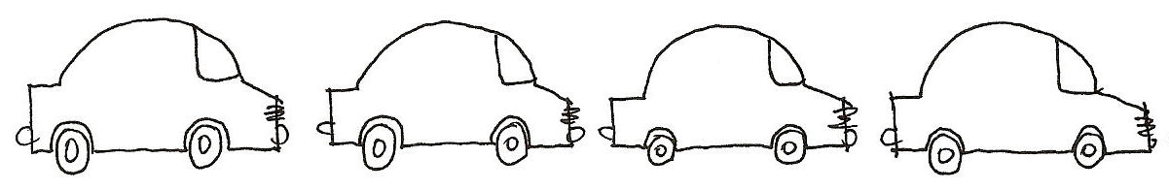
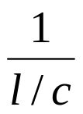
Case-by-Case Model
l
Cruising speed = c
Max outflow
vmax = (1 vehicle)/ (time for it to exit) = = c / l
L

Slide 48
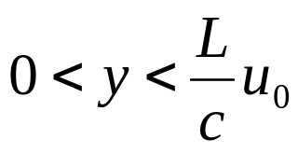
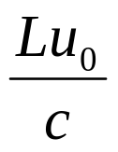
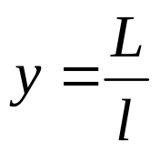

Case-by-Case Model: Three cases
No waiting line
  When
  Call N = (no waiting line volume)
Maximum waiting line
  When
  Call J = (jam volume)
Some waiting line
  When N < y < J
J
Max waiting line
Some waiting line
N
No waiting line
0
y
Notes:
Waiting line?

Slide 49
Case-by-Case Model: u & v
Inflow
Outflow
u = 0
Max waiting line
v = vmax
J
u = min (u0, vmax)
Some waiting line
v = vmax
N
No waiting line
v = min (u0, vmax)
u = u0
0
y

Slide 50
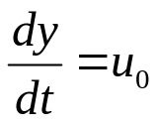

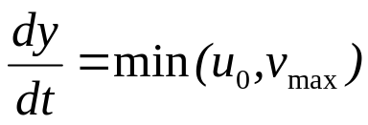
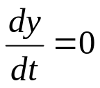
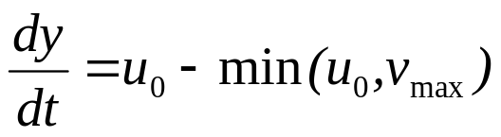
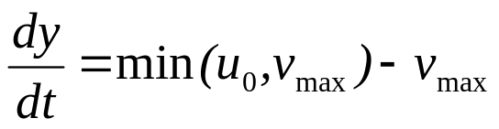
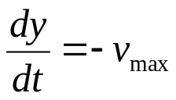
Case-by-Case Model: Equations
Red Light: if y N
if N < y < J
if y = J
Green Light: if y N
if N < y < J
if y = J

Slide 51
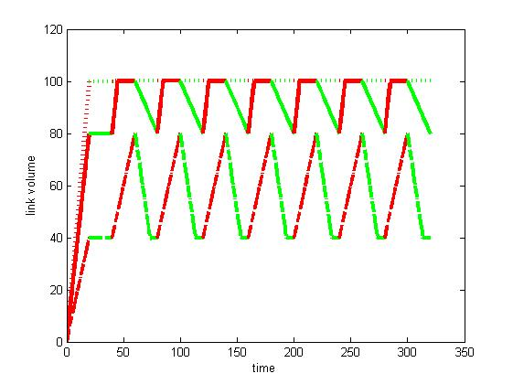
Case-by-Case Model: Plot
RL = GL = 20; L = 600; l = 6; c = 30 → J = 100; vmax = 5
u₀ = 2
u₀ = 4
u₀ = 6

Slide 52
Case-by-Case Model: Analysis
Constant Congestion/ “Crawling”
Cyclical Congestion
u₀ = 2
u₀ = 4
u₀ = 6
No Congestion
Notes:
Compare to data

Slide 53
Case-by-Case Model: Features
All features of M-C Model
3 congestion levels
Specific time periods of congestion
No permanent congestion
Disadvantage: discrete cases
  Critical link vol (N or J) for behavioral changes

